Slide 1
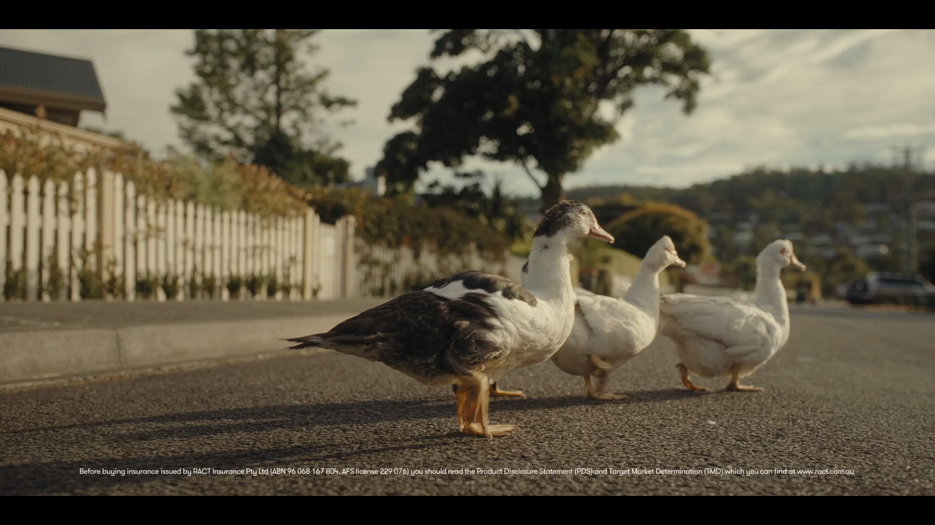
DRIVE SURE

